Slide 1
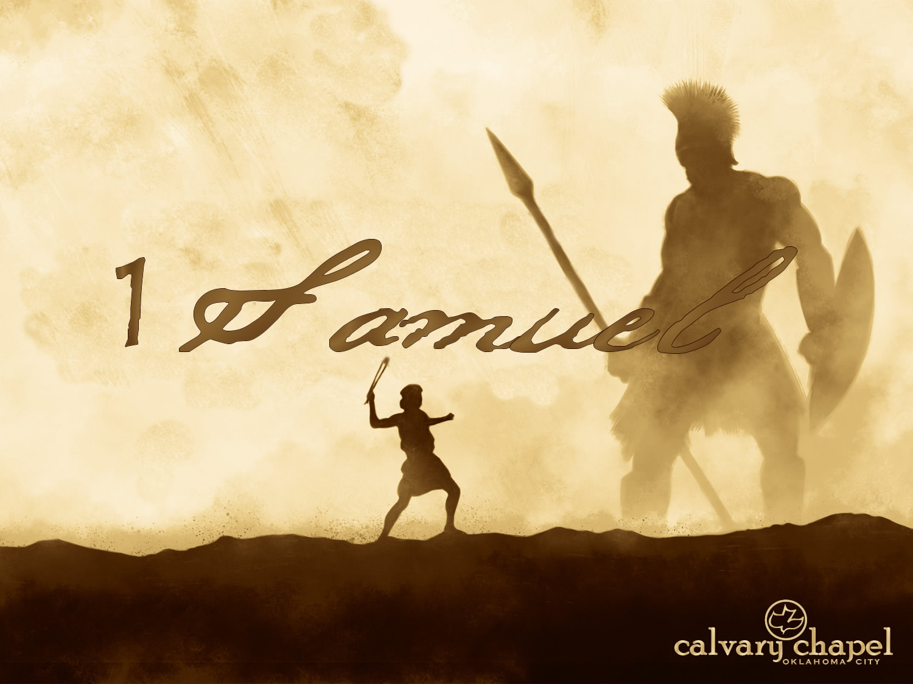

A CD of this message will be available (free of charge) immediately following today's message
This message will be available via podcast later this week at calvaryokc.com
17-18

Slide 2
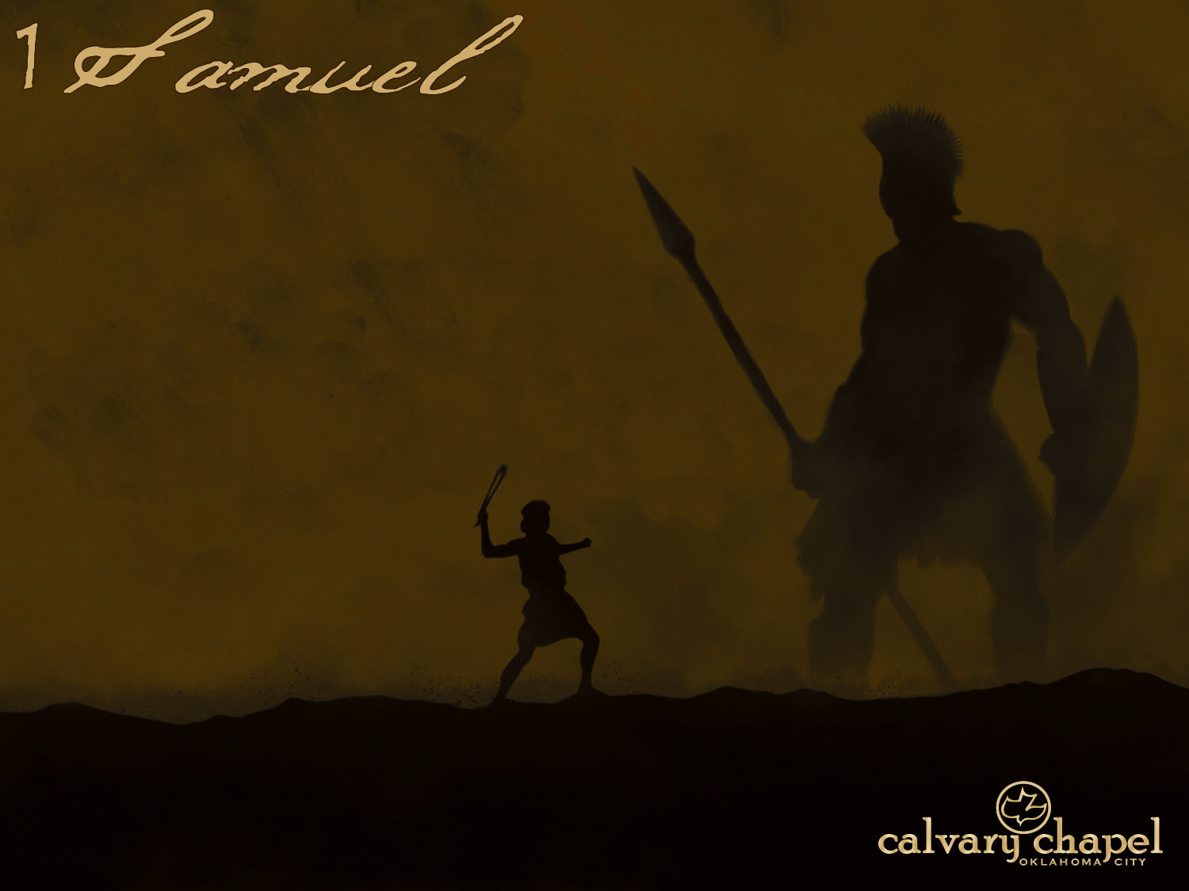
17-18
Cubit = 18"
Span = 9"
Shekel = < .5 oz.
5,000 shekels = 200 lb.
600 shekels = 25 lb.
9’ 9”

Slide 3
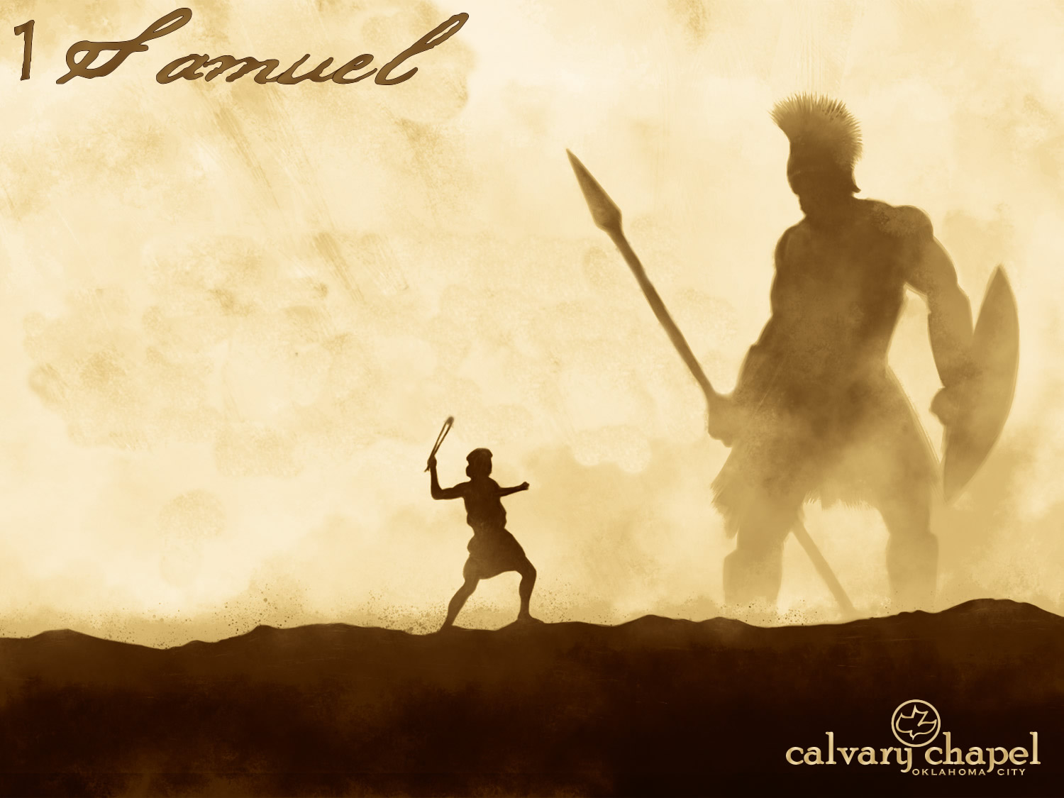
17-18

Slide 4
17-18
Cor. 1:9-10 ~ ⁹ Yes, we had the sentence of death in ourselves, that we should not trust in ourselves but in God who raises the dead, ¹⁰ who delivered us from so great a death, and does deliver us; in whom we trust that He will still deliver us,

Slide 5
17-18

Slide 6
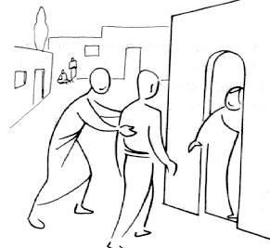
17-18
Insolence ~ KJV, naughtiness
GNB, You cheeky brat, you!

Slide 7
17-18

Slide 8
17-18
2 Cor. 1:10 ~ who delivered us from so great a death, and does deliver us; in whom we trust that He will still deliver us,

Slide 9
17-18

Slide 10
17-18
John Bunyan ~ "Religion is the best armor one can have, but it is the worst cloak."

Slide 11
17-18

Slide 12
17-18
The Message ~ He took one look down on him and sneered—a mere youngster, apple-cheeked and peach-fuzzed.

Slide 13
17-18

Slide 14
17-18
2 Cor. 10:4 ~ For the weapons of our warfare are not carnal but mighty in God for pulling down strongholds,

Slide 15
17-18

Slide 16
17-18
J. Sidlow Baxter ~ "As never before, my will and I stood face to face. I asked my will the straight question, “Will, are you ready for an hour of prayer?” Will answered, “Here I am, and I’m quite ready, if you are.” So Will and I linked arms and turned to go for our time of prayer. At once all the emotions began pulling the other way and protesting, “We’re not coming.” I saw Will stagger a bit, so I asked, “Can you stick it

Slide 17
17-18
out, Will?” and Will replied, “Yes, if you can.” So Will went, and we got down to prayer, dragging those wriggling, obstreperous emotions with us. It was a struggle all the way through. At one point, when Will and I were in the middle of an earnest intercession, I suddenly found one of those traitorous emotions had snared my imagination and had run off to the golf course; and it was all I could do to drag the wicked

Slide 18
17-18
rascal back. A bit later I found another of the emotions had sneaked away with some off-guard thoughts and I was in the pulpit, two days ahead of schedule, preaching a sermon that I had not yet finished preparing!
At the end of the hour, if you had asked me, “Have you had a ‘good time’?” I would have had to reply, “No, it has been a wearying wrestle with contrary emotions and a truant

Slide 19
17-18
imagination from beginning to end.” What is more, that battle with the emotions continued for between two and three weeks, and if you had asked me at the end of that period, “Have you had a ‘good time’ in your daily praying?” I would have had to confess, “No, at times it has seemed as though the heavens were brass, and God too distant to hear, and the Lord Jesus strangely aloof, and prayer accomplishing nothing.”

Slide 20
17-18
Yet something was happening. For one thing, Will and I really taught the emotions that we were completely independent of them. Also, one morning, about two weeks after the contest began, just when Will and I were going for another time of prayer, I overheard one of the emotions whisper to the other, “Come one, you guys, it’s no use wasting any more time resisting: they’ll go just the same.” That morning, for the

Slide 21
17-18
first time, even though the emotions were still suddenly uncooperative, they were at least quiescent, which allowed Will and me to get on with prayer undistractedly.
Then, another couple of weeks later, what do you think happened? During one of our prayer times, when Will and I were no more thinking of the emotions than of the man in the moon, one of the most vigorous of the emotions

Slide 22
17-18
unexpectedly sprang up and shouted, “Hallelujah!” at which all the other emotions exclaimed, “Amen!” And for the first time the whole of my being—intellect, will, and emotions—was united in one coordinated prayer-operation. All at once, God was real, heaven was open, the Lord Jesus was luminously present, the Holy Spirit was indeed moving through my longings, and prayer was surprisingly vital. Moreover,

Slide 23
17-18
in that instant there came a sudden realization that heaven had been watching and listening all the way through those days of struggle against chilling moods and mutinous emotions; also that I had been undergoing necessary tutoring by my heavenly Teacher."

Slide 24
17-18

Slide 25
17-18
Prov. 18:24 ~ A man who has friends must himself be friendly,
But there is a friend who sticks closer than a brother.

Slide 26
17-18

Slide 27
17-18
C. H. Spurgeon — "Make no friends with an angry man. As well make a bed of stinging nettles or wear a viper for a necklace. Perhaps the fellow is just now very fond of you; but beware of him, for he who barks at others today without a cause will one day howl at you for nothing. Don’t offer him a kennel down in your yard unless he will let you chain him up."

Slide 28
17-18

Slide 29
17-18
Prov. 27:20 ~ The refining pot is for silver and the furnace for gold, And a man is valued by what others say of him.
Warren Weirsbe ~ "The praise that made David humble only brought the dross to the top in Saul’s heart and revealed his pride and desire for glory."

Slide 30
17-18

Slide 31
17-18
Escaped ~ KJV, And David avoided out of his presence twice

Slide 32
17-18

